Slide 1
Platform Analysis
goals
check the scores’ dispersion
fit the analysis of the variance model
check the assumptions of models
Will platform influence scores?

Slide 2
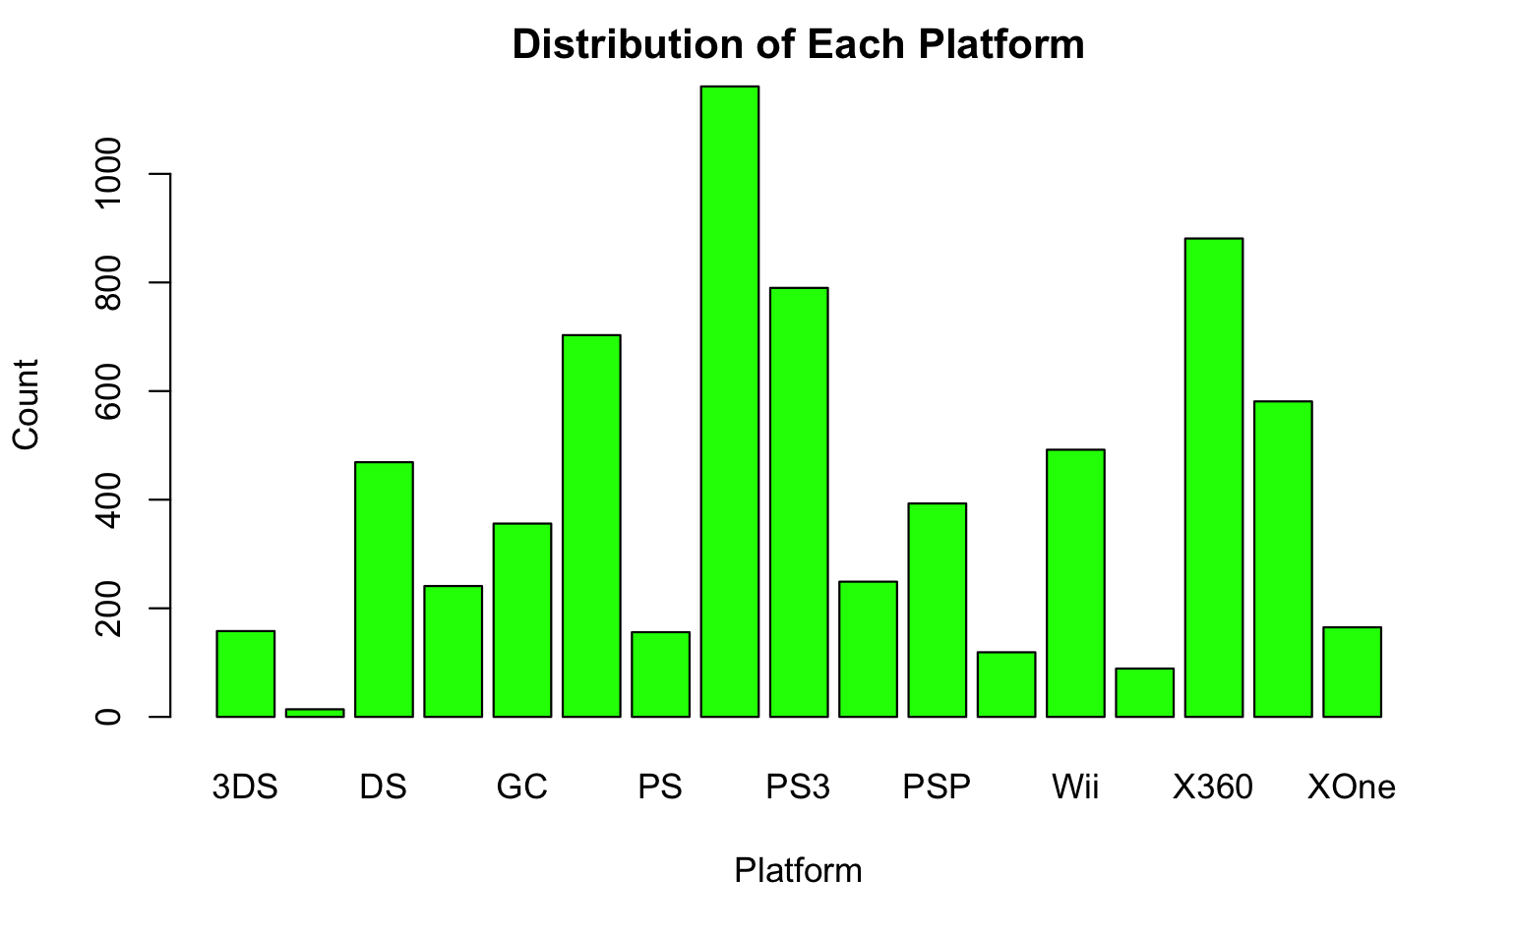
Platform Distribution
Platform name
Cases number

Slide 3
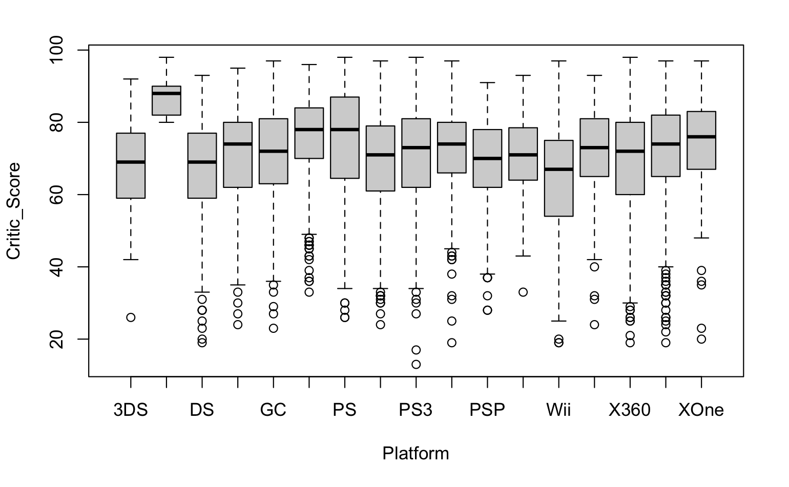
Critic scores’ dispersion
Different platform has different average critic scores.
DC platform has the highest critic score, but since it only has 14 cases, it may be unconvincing. The Wii platform has the lowest critics scores.
Most platforms have symmetric critic scores, and their score variances are similar.
Critic scores data is convincing and relatively fair

Slide 4
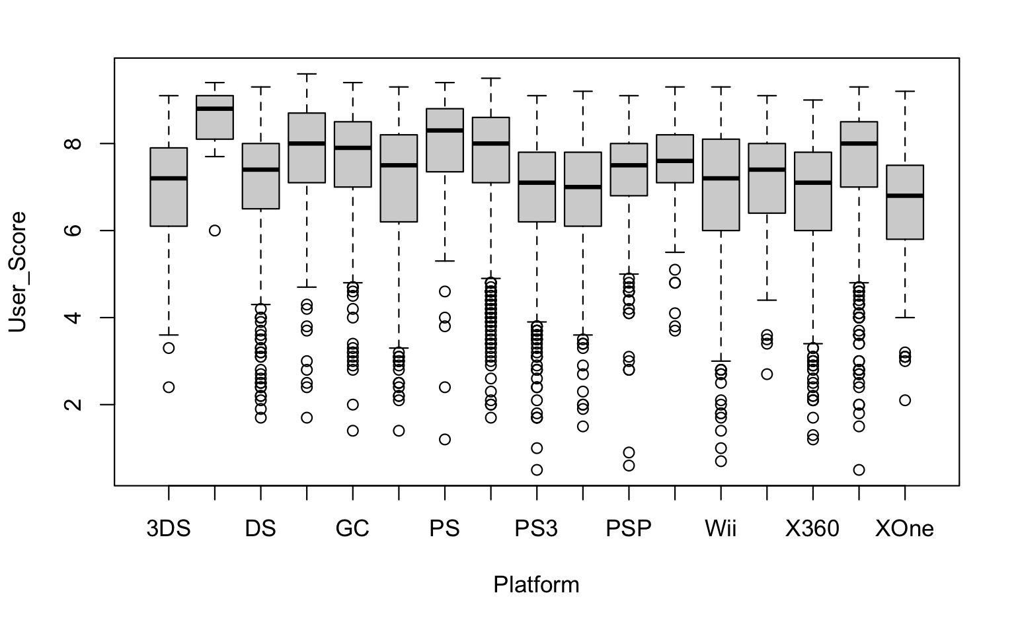
User scores’ dispersion
Different platform has different average user scores. We can notice that PS and PS2 games have obviously higher user-score than PS3.
DC platform also has the highest user score. The XOne platform has the lowest user scores.
Most platforms have symmetric user scores.
User scores data is convincing and relatively fair

Slide 5
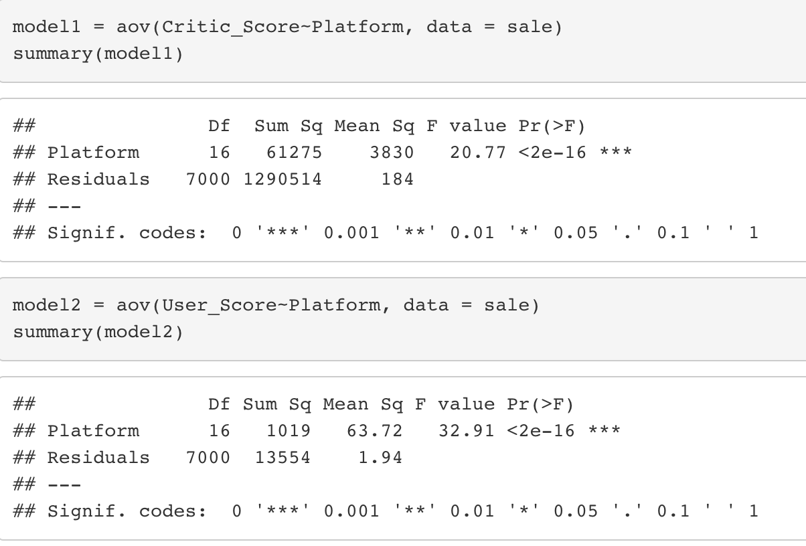
Analysis of the Variance Model
P < 2e-16,
The platform has a significant effect on the Critic Score and User Score at the 1% level.

Slide 6
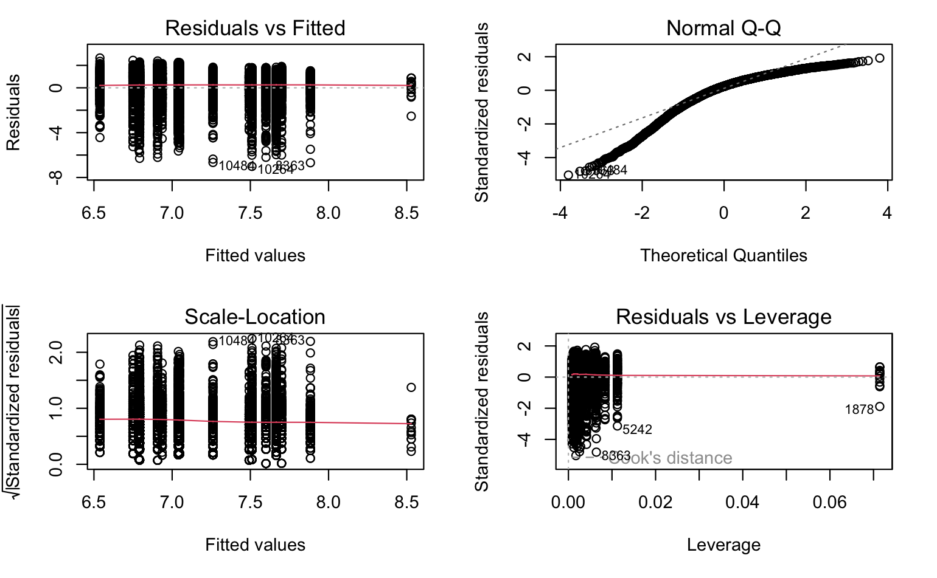
Critic-Score diagnostic plot
In the third plot, all points are below 1.0, and the red line is horizontal, indicating that the variances are similar.

Slide 7
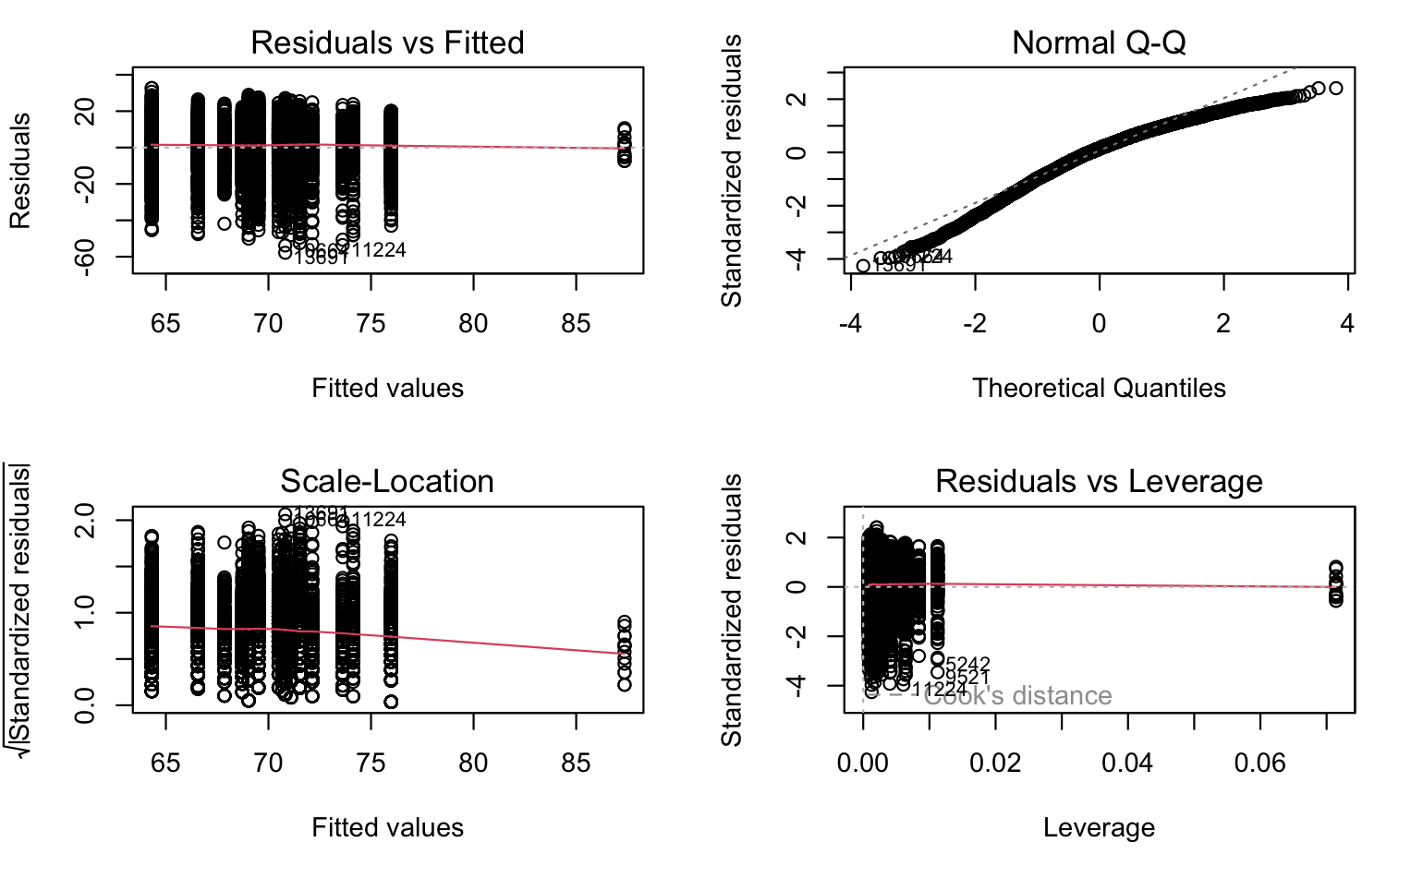
User-Score diagnostic plot
The quantile plot shows some departures. In the third plot, all points are below 1.0, and the red line is horizontal, indicating that the variances are similar.

